Slide 1
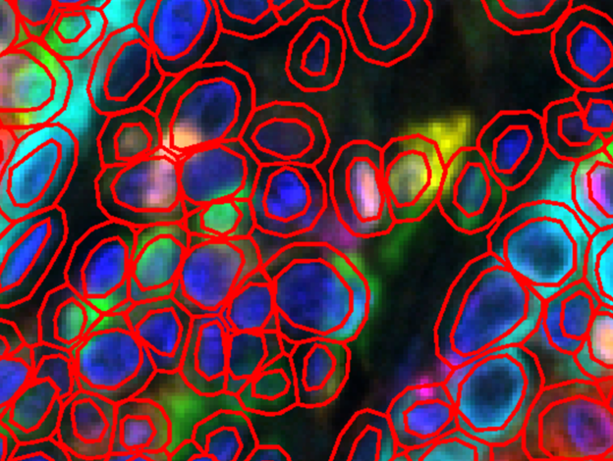
Infosys_Springboard_Oct2024
PROJECT CYTOAUTOCLUSTER:-
A Study of Mass Cytometry in Cells
PRESENTED BY:-
ANIRUDDH JOSHI

Slide 2
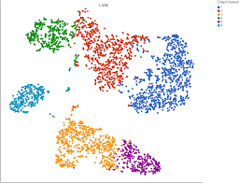
Table of Contents:-
01. Project Overview
02. Selecting the Right Dataset
03. EDA Techniques
04. Visualizing Data
05. Data Corruption and Splitting
06. Machine Learning Models
07. Semi-Supervised Learning & Metrics
08. Visualizations and Gradio Demo

Slide 3
Project Overview:-
CytoAutoCluster is an advanced solution for clustering cells based on unique characteristics. Using semi-supervised learning, it enhances clustering accuracy and computational efficiency, providing valuable insights into cellular data.
Semi-Supervised Learning: Leverages both labelled and unlabelled data to enhance clustering accuracy.
Efficient Cell Grouping: Segments cells into distinct clusters based on nuanced features.
Optimized for Performance: Handles large datasets with speed and precision.
Interpretability: Visualizes and explains cluster distributions clearly.
Scalability: Manages large, complex datasets without compromising performance.

Slide 4
Exploratory Data Analysis (EDA) Techniques
Null vs. Non-Null Values
Visualization: Bar Plot
Purpose: Identify missing data patterns to guide imputation or removal strategies.
Class Label Distribution
Visualization: Bar Plot
Purpose: Analyze class balance to address potential biases in the dataset.
Histograms of Numerical Features
Purpose: Assess patterns such as normality, skewness, and the presence of outliers in the data.
Box Plots and Count Plots
Visualization: Box Plot (for medians and outliers), Count Plot (for categorical distributions)
Purpose: Visualize feature distributions, highlight medians, and detect potential outliers.

Slide 5
Model Overview:-
Model Used
1. Logistic Regression
- Predicts binary outcomes by modeling the relationship between a binary target variable and multiple independent variables.
- Optimized for probability estimation and classification tasks.
2. XGBoost (Extreme Gradient Boosting)
- Builds robust decision trees iteratively for enhanced predictive performance.
- Handles complex patterns and interactions in high-dimensional data efficiently.
3. Semi-Supervised Learning Model
- Combines labeled and unlabeled data for enhanced learning.
- Key Features:
- Utilizes **Consistency Regularization** to stabilize predictions under data perturbations.
- Applies **Entropy Minimization** to reduce prediction uncertainty on unlabeled data.

Slide 6
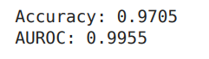
Model Workflow
Training:
Supervised loss is computed on labeled data using Logistic Regression and XGBoost.
Semi-supervised learning leverages unlabeled data to refine the model.
Prediction:
Encoded features are fed into the model for generating predictions.
t-SNE applied to visualize clustering improvements post-training.
Evaluation:
Log loss and classification accuracy measure performance.
Gradio Interface enables interactive result visualization for inputs.
Semi-Supervised Techniques: Leveraging Autoencoders for feature extraction.
Performance Metrics: Evaluation criteria for model effectiveness

Slide 7
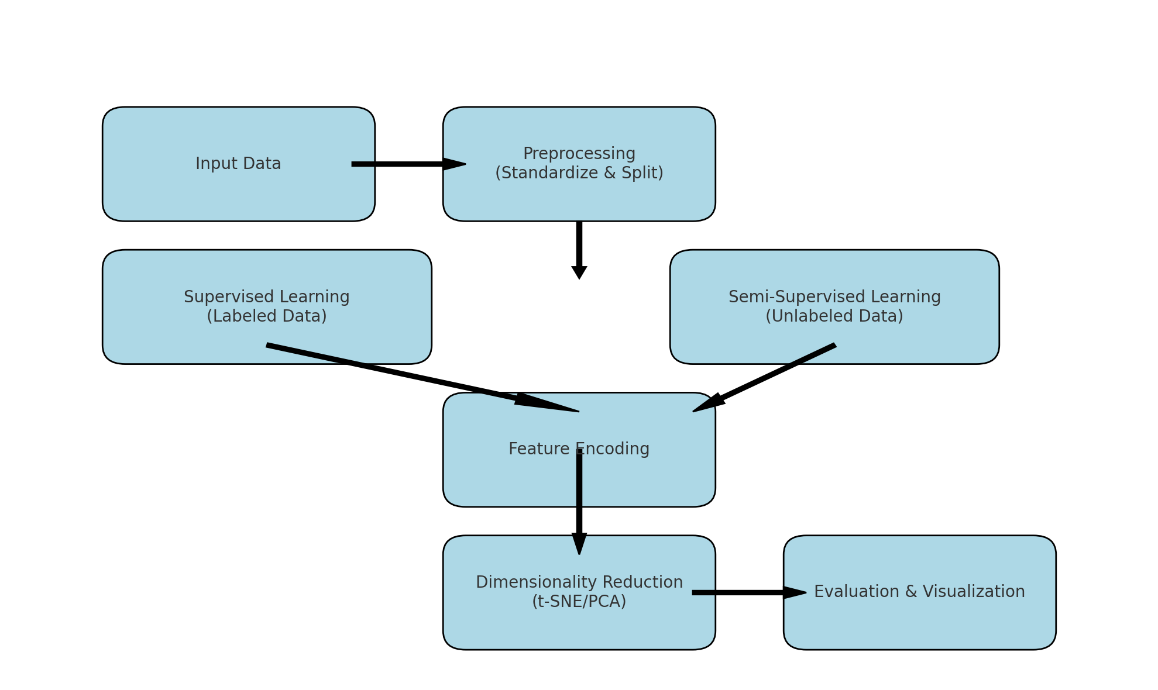

Slide 8
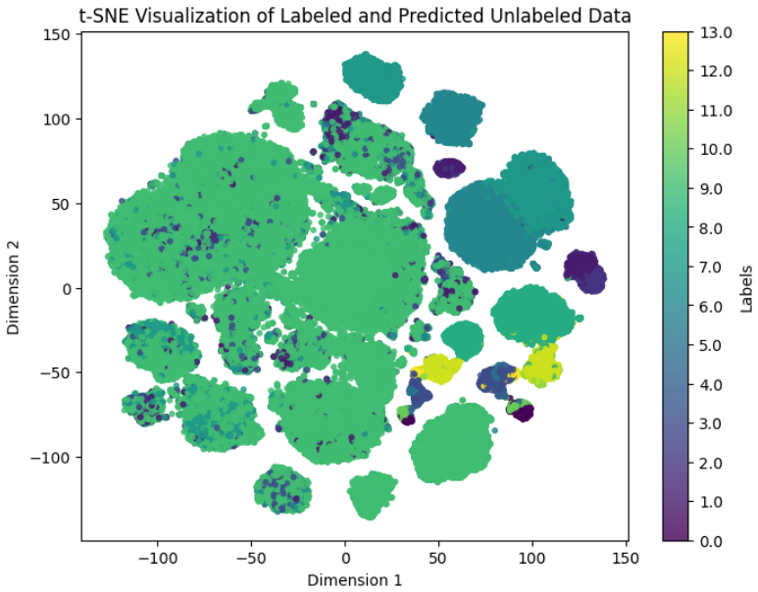
Final t-SNE Visualization
Displays the improved clustering results after applying the semi-supervised learning model. Highlights how the model refines cluster separability and aligns with biological significance.
Gradio Demo
Provides an interactive web-based interface to input data and visualize predictions. Facilitates analysis by plotting cluster distributions for easier interpretation and validation.

Slide 9
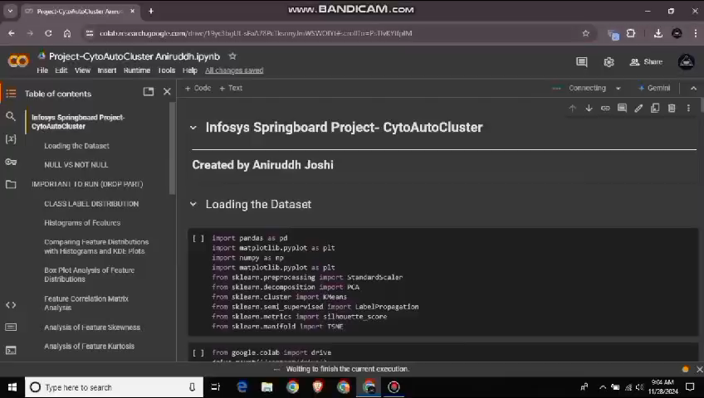

Slide 10
